Slide 1
Geometric and Textural Blending for 3D Model Stylization
Yi-Jheng Huang^{1,2}, Wen-Chieh Lin¹
I-Cheng Yeh², Tong-Yee Lee³
¹ National Chiao Tung University
² Yuan Ze University
³ National Cheng Kung University
Notes:
Hi, everyone, it’s my pleasure to present our work.
I am Yi-Jheng Huang. We from National Chiao Tung University, Yuan Ze University and National Cheng Kung University.

Slide 2
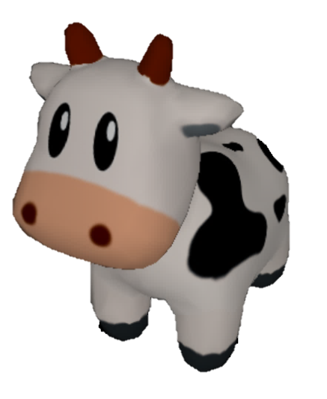
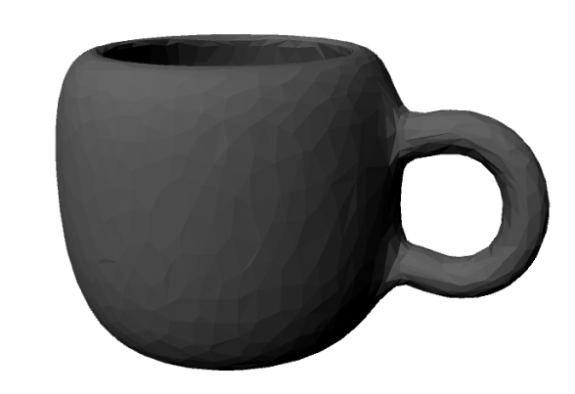
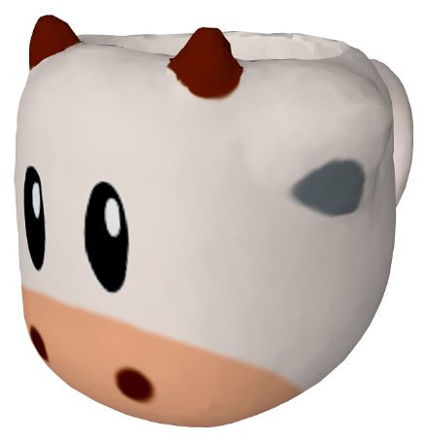
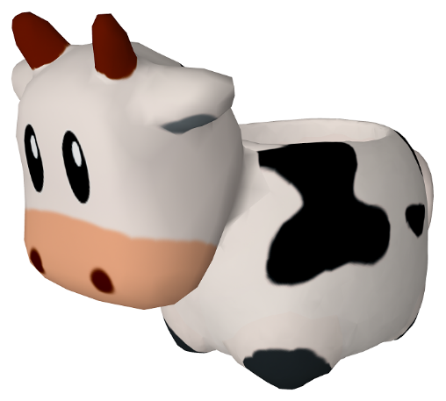
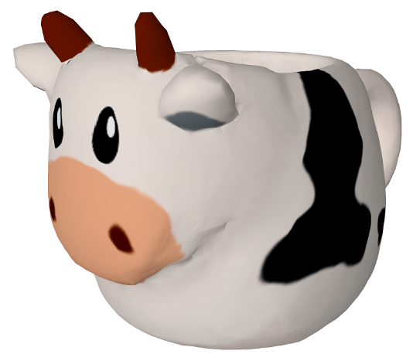
Inputs and Outputs
Applications:
Product design
Inspiration
Provide drafts
Style model
Base model
Blended models
Notes:
Here are the inputs of our system.
In this paper, we propose a model stylization method.
Given two models, a style model, a base model, our system can generate multiple blended models.
And the blended models will preserve the features of the given models.
Some possible applications include product design, inspiration, and providing drafts

Slide 3
Definition of Style
Some researches of 3D model stylization define “style” as defined as concise curves [1][2].
We define “style” as the characteristics of representative objects. These characteristics include color appearances (texture) and geometric features.
[1] H. Li, H. Zhang, Y. Wang, J. Cao, A. Shamir, and D. Cohen-Or, "Curve style analysis in a set of shapes," Computer Graphics Forum, 2013.
[2] Z. Han, Z. Liu, J. Han, and S. Bu, "3D shape creation by style transfer," The Visual Computer, 2015.
Notes:
Let me we define the term “style” used in this study.
Some studies define “style” as concise curves.
However, in this study, we define “style” as the feature of representative objects. These characteristics include color appearances (texture) and geometric features.

Slide 4
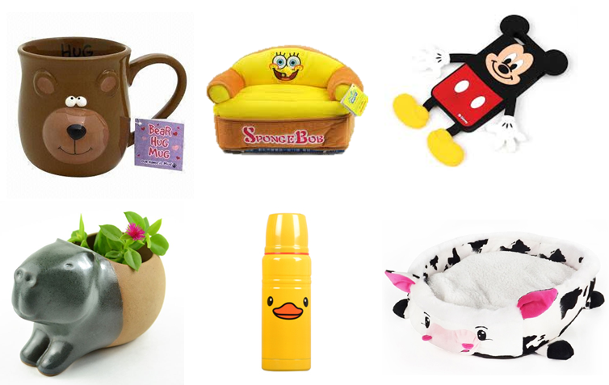
Method — Observation of Design Strategies
Deform
Change color
Attach
Notes:
Before we describe the method, let’s talk about some observation.
We observe some stylized products used in our daily life.
We found that there are three strategies that are commonly used in designing stylized products.
The first strategy is “deform”.
The shape of a product may be changed to fit a certain style.
The second strategy is “change color”.
Designers only change the color, and do not change the shape of a product.
The third strategy is “attach”.
Designers attach several components to the product, and without change the shape of a product.

Slide 5
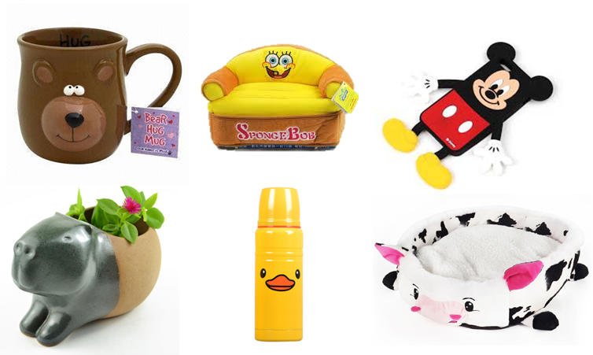
Fundamental Operations
“Deform” and “change color” are essentially the same
Both can be handled by morphing techniques, which we call mixing in this paper
Mix
Attach
Notes:
And then, we find that … strategies “deform” and “change color” are essentially the same.
They can be handled by morphing techniques in computer graphics.
We call it “mix” operation in this paper.
And the strategy “attach” is same.

Slide 6
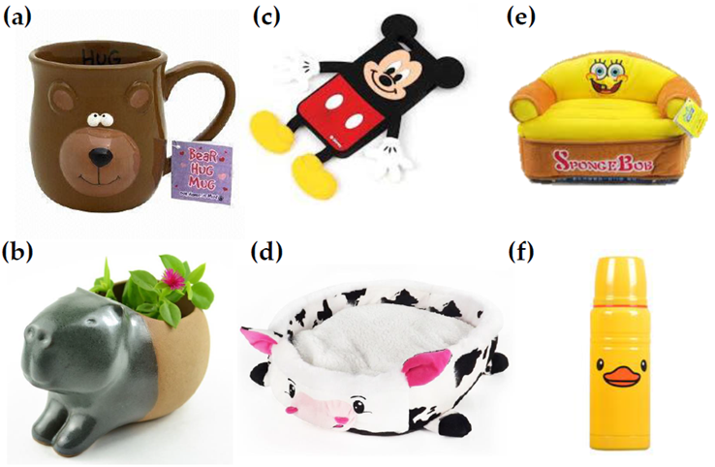
Issues to Be Solved
Which component will be operated?
Which component will be attached?
Which component will be mixed?
How to mix? Morphing
Notes:
So, we summarize the issues to be solved as follow:
Not entire model is operated. Which component will be operated?
Which component will be attached?
Which component will be mixed?
How to mix? We use morphing technique in this paper.

Slide 7
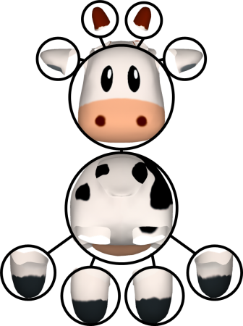
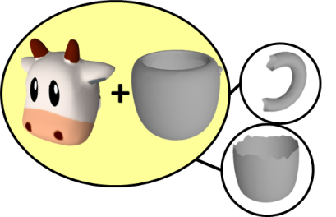
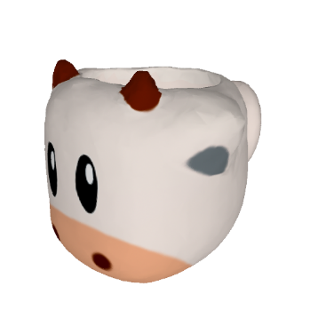
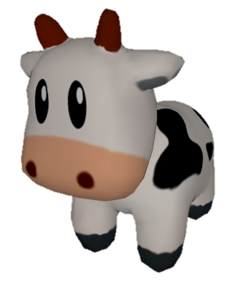
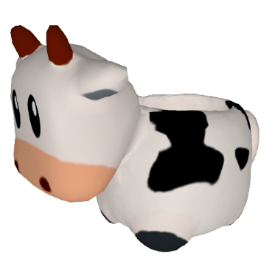
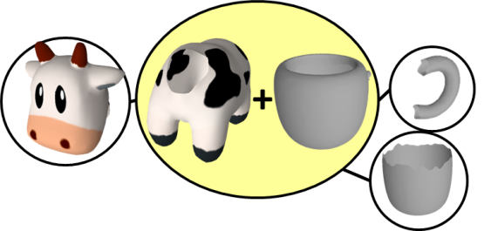
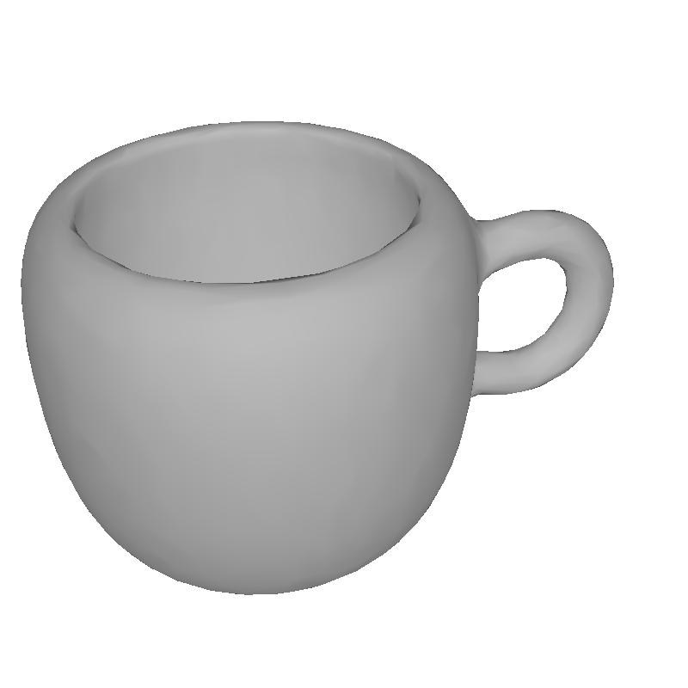
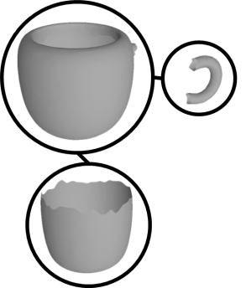
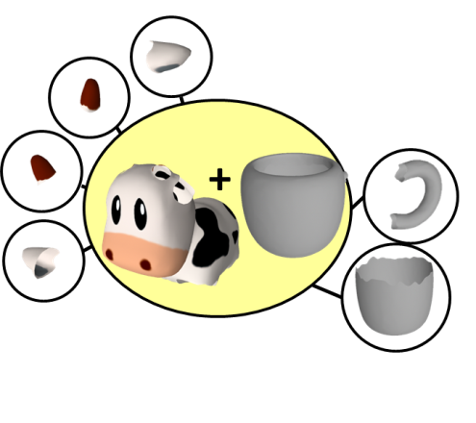
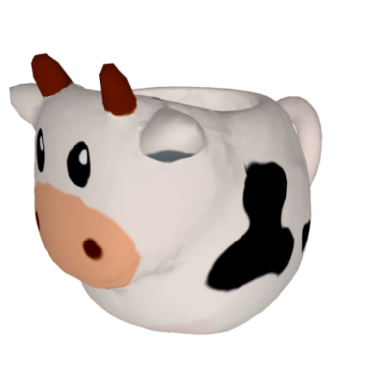
System Flow
①
①
Style model
②
②
③
③
Base model
Preprocessing
Topology blending
Surface blending
Decide mixed and attached components
Mix: geometric and textural blending
Notes:
Based on the observations, we design the system flow as follow.
Here is input models.
The first step is preprocessing. We extract some information in this step.
The second step is topology blending. Here we decide which components will be mixed and be attached.
The third step is surface blending. We geometrically and texturally blend two input models in this step.
I will explain each step in the following slides.

Slide 8
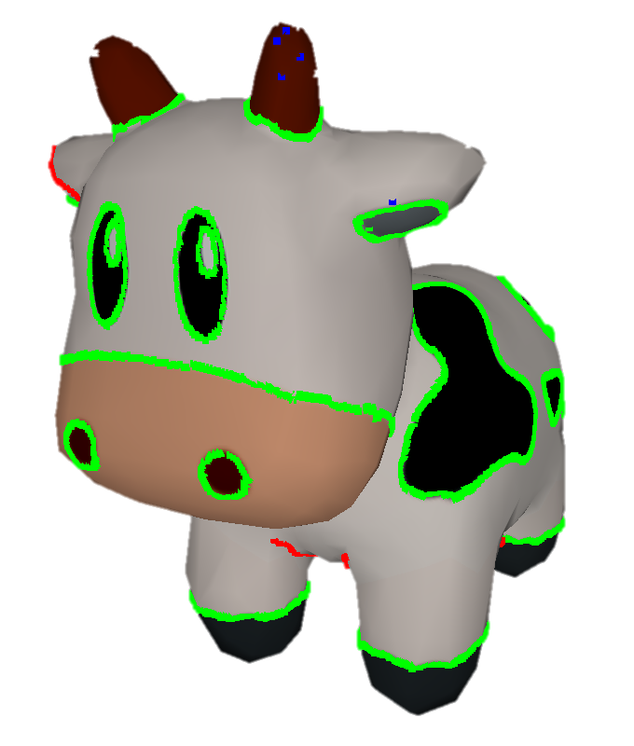
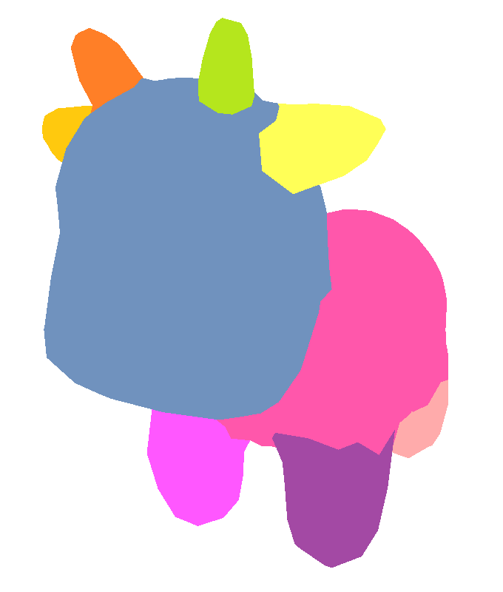
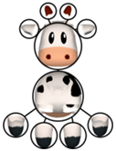
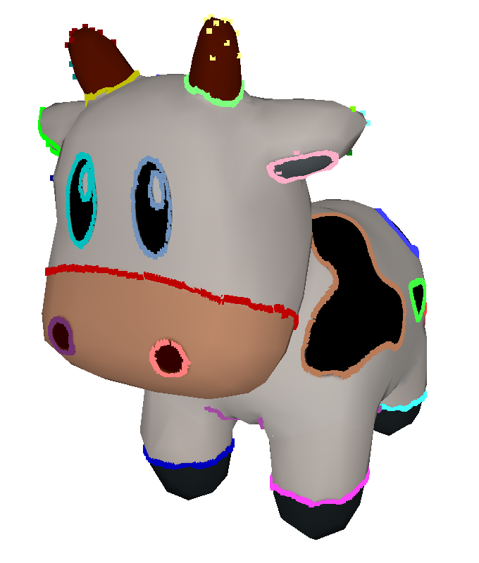
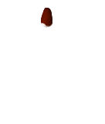

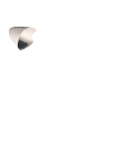
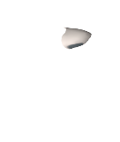
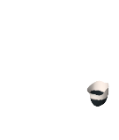
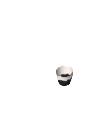
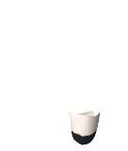
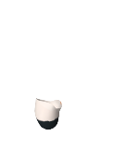
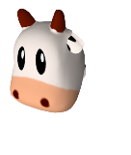
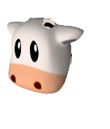
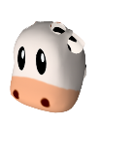
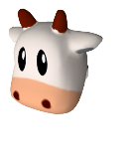
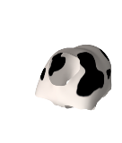
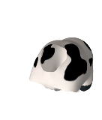
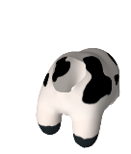

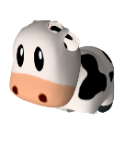
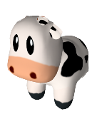
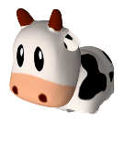
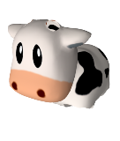
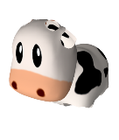
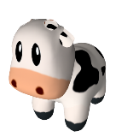
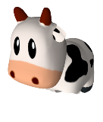

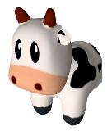
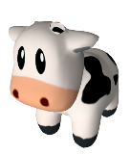
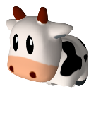
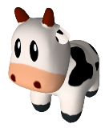
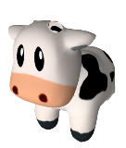
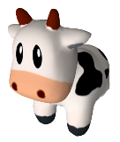
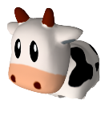

Preprocessing
Green: Texture edge points
Blue: Curvature points
Red: Ridge points
Input
Segments
Topology
Parts
Features
Notes:
In preprocessing step, we extract some information from input models.

Slide 9

Topology Blending
Which part will be operated?
Represented by an operational vector
Merged graph
Merged graph
Notes:
After preprocessing, the next step is topology blending.
This step will decide which part will be operated.
We represent the combination information as an operational vector.
And then, an operational vector can be converted to a merged graph.
A merged graph can represent a blended model in our system.

Slide 10










Example
Merged graph
1
2
3
4
5
6
1
2
3
4
5
6
1
2
3
4
5
6
∅
∅
16
∅
∅
∅
∅
∅
12
∅
∅
∅
Mix
Operational vector
Attach
Surface
blending
16
12
An operational vector represents a blended model.
Notes:
Here is an example.
First, for each input model, we have it parts. Parts are some possible combinations of a model.
And then, here is an operational vector and its merged graph.
Let’s me explain how we convert an operational vector to a merged graph.
An operational vector has two portions. One is for mix operation, another is for attach operation.
This element means the 16th part of style model will mix with the third part of base model. In other words, the yellow node in the merged graph.
And this element means the 12th part of style model will attach to the third part of base model. In other words, the head node in the merged graph.
The rest nodes are the rest part, that have no operated and from base model.
Based on the information of merged graph, we can generate a blended model.
So, an operational vector can represent a blended model.

Slide 11
Tree Growing Algorithm
Search for all possible combinations by tree growing
Filter out implausible combinations by rules
Operational vector
∅
…
…
1
2
∅
∅
…
∅
∅
∅
∅
…
∅
∅
…
…
n
…
n
1
∅
n
…
1
1
1
∅
…
n
…
…
2
n
∅
n
∅
…
2
2
2
…
…
∅
…
∅
…
…
…
…
n
…
n
n
n
n
n
n
n
Notes:
We use a tree growing algorithm to generate operational vectors.
The main idea is searching for all possible combinations by tree growing.
We filter out implausible combinations by rules.
Let’s me show an animation to demonstrate the algorithm.
First, we have a root of a tree.
It will grow all possible combinations for next level.
For each node, we will check if it is a plausible node.
If not, we mark it, and the node will not grow anymore.
Then we grow the tree for next level. Check if they are plausible.
We do it iteratively, until the high of the tree is equal to the length of the vector.
Then we will have some plausible operational vectors.

Slide 12



Plausibility Rules
A merged graph cannot contain repeating segments
Importance preserving
Symmetry preserving
Penetration avoidance
Similarity
Size preserving
Notes:
Here are plausibility rules we used in the paper to filter out implausible combinations.
They are …
1. A merged graph cannot contain repeating segments
2. Importance preserving
3. Symmetry preserving
4. Penetration avoidance
5. Similarity
6. Size preserving
Here are some failure cases which are filtered out by the rules.

Slide 13
Surface Blending
(a)
(b)
(c)
(d)
①
①
②
②
Style model
③
③
Base model
Preprocessing
Topology blending
Surface blending
Implement by morphing
Finding correspondence is important
Notes:
After topology blending, the next step is surface blending.
We will generate blended models in this step.
We implement by morphing technique.
Therefore, finding correspondence is important here.

Slide 14

Flow of Surface Blending
Find feature correspondence according to textural and geometric information
Two steps:
Find the rest correspondence by using spherical parameterization and warping
Notes:
The flow of surface blending includes two steps:
First, finding feature correspondence according to textural and geometric information
Second, find the rest correspondence by using spherical parameterization and warping.
We will explain how we find feature correspondence, step by step, in the following slides.

Slide 15



Initial State
Base part
Style part
Features of style part + base part
Notes:
Here is the initial state. We have a base part and a style part.
We put them together.
In the following slides, to better describe our method.
We only show the feature of style part and the shape of base part.
We define the point cloud in a color is a feature.

Slide 16

Step 1. Sampling
Reduce the number of points
Notes:
The first step is sampling, it reduces the number of points.

Slide 17

Step 2. Uniform Scaling
The distributions of style features are fitted with the axis-aligned bounding box (AABB) of a base part
Notes:
And the next step is uniform scaling.
The distributions of style features are fitted with the AABB of a base part

Slide 18


Step 3: Rigid Matching Step 4: Soft Matching
Problem: for each point in features, we find a corresponding point on base surface
Formulated as two unconstrained optimization problems
Surface of style part
Surface of base part
Rigid matching
Soft matching
Notes:
The next steps are rigid matching and soft matching.
We find feature correspondence in these steps.
The problem here is, for each point in features, we find a corresponding point on base surface.
We formulated it as two unconstrained optimization problems.
Let me explain rigid matching and soft matching, separately.

Slide 19

Step 3: Rigid Matching
Objectives:
Let features close to the surface of base part
Preserve the relative position between features
For each feature, calculate a rigid transformation
To preserve the relative position between features, represent the relative position between features as links whose lengths are maintained
e : e_{ij} = p_{i} – p_{j}
e' : e’_{ij} = M_{i}p_{i} - M_{j}p_{j}
F : feature
𝕋 : 𝕋 = {M₁, M₂, …, M_{n}}
𝔽 : 𝔽 = {F₁, F₂, …, F_{n}}
M : transformation matrices
p : point
d : desired point
Notes:
Rigid matching.
The objectives of rigid matching are:
First, let features close to the surface of base part
Second, preserve the relative position between features
For each feature, calculate a rigid transformation
To preserve the relative position between features, we represent the relative position between features as links whose lengths are maintained
We formulate it as an equation and solve the optimization.

Slide 20



Step 4: Soft Matching
Problem: points are not onto the surface of base model after rigid matching
Calculate each feature independently
Objectives:
Let points lay on the surface of base part
Preserve the shape of feature pattern
To ensure that points will be onto the surface, represent point positions by Barycentric coordinate
To preserve the shape of feature pattern, represent the shape of feature pattern as links whose lengths are maintained
ℝ : {r₁, r₂, r₃, … r_{3n}}
B : Barycentric coordinate, B(f, r) = r₁v₁ + r₂v₂ + r₃v₃
l : l_{jk} = B(f_{j}, r_{j}) - B(f_{k}, r_{k})
p : point
f : triangle (v₁, v₂, v₃)
Notes:
The next step is soft matching.
There is a problem after rigid matching.
Points are not onto the surface of base model after rigid matching.
The feature correspondence is not yet established.
In this step, we try to solve this problem.
We calculate each feature independently.
The objectives of soft matching are:
First, let points lay on the surface of base part
Second, preserve the shape of feature pattern
To ensure that points will be onto the surface, we represent point positions by Barycentric coordinate
To preserve the shape of feature pattern, represent the shape of feature pattern as links whose lengths are maintained.
We formulate it and solve the optimization.
So, after soft matching, the points will onto the surface of base model

Slide 21


Slide 22






Results
Diversity
0.2
0.4
0.6
Style
0.8
1.0
Base
Style
Base
Notes:
Here is our results.
For each pair of input models, we show all their blended models.
We can see the variety of blended models, and all blended model maintain the characteristic of input models.

Slide 23

Bear + Beanbag
Notes:
Here are more selected results of other inputs.

Slide 24

Elephant + Cup

Slide 25

Penguin + Phone Case

Slide 26

Notes:
Our method also can handle complex texture and shape.

Slide 27

Comparison with Zoomorphic [1]
15 males and 15 females aged between 19 and 30 years old were invited
Watched eight pairs of blended models played in a random order
For fairness, only compared the results of geometric models
Participants were asked to judge the models
Our
[1]
[1] N. Duncan, L. Yu, S. K. Yeung, and D. Terzopoulos, “Zoomorphic design,” SIGGRAPH, 2015.
Notes:
A user study is conducted to compare our results with another paper, zoomorphic.
15 males and 15 females were invited.
We show both our results and zoomorphic’s results to the participants.
Each participant watched eight pairs of blended models played in a random order
For fairness, we only compared the results of geometric models
Participants were asked to judge the models

Slide 28

Comparison Results
Our
[1]
[1] N. Duncan, L. Yu, S. K. Yeung, and D. Terzopoulos, “Zoomorphic design,” SIGGRAPH, 2015.
Notes:
They judged the models in four aspects: personal preference, reasonableness, style preservation and functionality preservation.
The experiment showed that our models are better on personal preference, reasonableness and functionality preservation.
However, only 44% of the participants thought our approach are better on style preservation.
Especially in the bear beanbag case and penguin case.
For the bear beanbag case, participants said the shape of the zoomorphic models “looks more like the style model,” . However, “the head (in our bear beanbag) disappears.”
This is because, only geometry was provided, and we represented the head of bear by texture in this case.
For the penguin case, our model does not maintain the form of the penguin; instead, we maintained the form of the phone case.
But this is a trade off, because the penguin form may lose the functionality of the phone case.

Slide 29

Conclusion and Future Work
A model stylization framework is established by topologically, geometrically and texturally blending a functional model with a style model
Future Work
Other approaches for defining the rules, e.g., learn from examples
More deform methods, e.g., Laplacian surface editing, extract the skeleton of input models and deform models by transforming the skeleton
More design strategies, e.g., model abstraction
Users can modify details
Notes:
Conclusion and Future Work.
In this paper, a model stylization framework is established by topologically, geometrically and texturally blending a functional model with a style model
There are some possible directions.
First, we use rules to filter out implausible models, but those rules do not address the core of functionality, and may be heuristic. So, maybe we can use other approaches for defining the rules, like, learn from examples.
Second, now, in paper, we use only morphing technique to deform the models. Maybe we can use more deform methods. Like, Laplacian surface editing, or extract the skeleton of input models and deform models by transforming the skeleton
Third, we can apply more design strategies, like model abstraction.
4th, we can provide more friendly user interface, that allow users to modify more details.

Slide 30
Thank you
Notes:
Thank you for your listening.

Slide 34

Motivation
Stylized products: functional products that possess the form or appearance of an animal or a character
Difficult to create using conventional modeling tools
Goal: enable the users to create stylized models with simple actions

Slide 35

Failure Cases
Fail on identifying target point d :
The texture pattern of bear hands is not preserved well because the inverse matching of the texture pattern
Fail on mesh warping:
to avoid foldover faces, not all vertices are warped to their desired positions

Slide 36


Step 2. Uniform Scaling — Example
Base part: cone
Style part: cow
AABB of a base part
(a) Before
(b) After
Notes:
可以看到 feature 的位置被都 scale 進 bounding box 裡面了

Slide 37
Computational Time of Topology Blending
Computational time (seconds)

Slide 38

Computational Time of Surface Blending
Notes:
我們這邊的warping採用漸進式的warping
也就是要從A點warp到B點，在實作上，拆成了10份
此外，若發現有fold，還會再把fold區域的三角形切細，因此花了比較多的時間

Slide 39
Parameterization and Warping
Both style and base meshes are mapped to a unit sphere [15][16]
The two spherical parameterizations are aligned with the features by using foldover free warping [35]
Two meshes are warped iteratively until the vertices of one mesh reached the target positions. When a foldover triangle is detected, the mesh is recovered to the previous iteration, and the mesh around the folded triangles is refined. When the number of folded triangles exceeded 5000, warping is stopped and supermeshing is carried out directly
A supermesh that contains both style and base meshes information is built by adopting a previous approach [34]
[15] M. Alexa, “Merging polyhedral shapes with scattered features,”The Visual Computer, 2000.
[16] L. Shen and F. Makedon, “Spherical mapping for processing of 3D closed surfaces,” Image and Vision Computing, 2006.
[34] J. Parus, “Morphing of meshes,” Technical Report No. DCSE/TR-2005-02, 2005.
[35] Y. Ma, J. Zheng, and J. Xie, “Foldover-free mesh warping for constrained texture mapping,” IEEE TVCG, 2015.

Slide 40

Elephant + Pillow

Slide 41









Style model
Base model
(1) Points
(2) Clusters
(3) Segments
(4) Topologies
(5) Parts and groups

Slide 42
Finding rest correspondence
Spherical parameterization + Warping + Supermeshing
Notes:
有了對應點之後
接下來就是根據對應點的位置
計算出一個可以被 morphed 的模型
有對應點算 morphed 的模型
這個問題以前有很多人討論過
在這裡，我們使用的是球形參數化，搭配warping的方式的解法
但也可以替換成其他方法

Slide 43





Other Attempt
Current method
[1] I-Cheng Yeh, Chao-Hung Lin, Olga Sorkine, Tong-Yee Lee, "Template-based 3D Model Fitting Using Dual-domain Relaxation," IEEE TVCG, 2011
[1] (fix feature points)
Notes:
回應上次老師們提出為什麼要用 Spherical parameterization + warping
其實後來我也嘗試了一些其他方法
左上是現在的結果
左下是一篇2011年的paper的結果，可以看到兔子耳朵的pattern往內縮，沒有維持得那麼好
//他們的方法是直接把點，再 iteratively 的 fitting
然後我又試著把特徵點的位置固定住
但這樣會導致出來的結果有 fold
所以這個部分，還可以繼續探討，看怎麼改進

Slide 44
Conclusion
We propose approaches for styling and transforming 3D models
Styling: an approach that can automatically generate stylized models was developed. The results showed that the proposed system can blend two models in various topologies and geometries while preserving the texture patterns and geometric features of the style model.
Transforming: the approach for making and animating a transformable model is proposed. Users only need to provide a source model and a target skeleton, and our system can segment the source model and generate a transformation animation
Notes:
the approach for making and animating a transformable model is proposed. Users only need to provide a source model and a target skeleton, and our system can segment the source model and generate a transformation animation.

Slide 45
Limitations
The current method only optimizes the skeleton
A two-level optimization, which first optimizes the skeleton then the segmentation, may generate better results
Our current transformable models can only be used in animation, and cannot be 3D printed as physical objects
Consider the connection positions between parts
Consider the geometry of connection joints

Slide 46
Step 3: Rigid Matching
Objective:
Let features close to the surface of base part
Preserve the relative position between features
For each feature, calculate a transformation matrix
To preserve the relative position between features, represent the relative position between features as links whose lengths are maintained

Slide 47
Step 3: Rigid Matching
On base surface
Let points close to the surface of base part
Preserve the relative position between features
e : e_{ij} = p_{i} – p_{j}
e' : e’_{ij} = M_{i}p_{i} - M_{j}p_{j}
F : feature
𝕋 : 𝕋 = {M₁, M₂, …, M_{n}}
𝔽 : 𝔽 = {F₁, F₂, …, F_{n}}
M : transformation matrices
p : point
d : desired point

Slide 48

Desired Point
Texture edge points
Curvature points
Ridge points
p | d (desired point)
Texture edge points | A point on the surface of the base part that is closest to p
Curvature points | The closest curvature point on the surface of base part
Ridge points | The closest ridge point on the surface of base part
Base part
Notes:
此外，為了確保 matching 的合理性，一組 matched pair 的距離必須小於某個 threshold，我們會取消這個配對

Slide 49
Step 4: Soft Matching
Problem: points are not onto the surface of base model after rigid matching
Calculate each feature independently
Objective:
Let points lay on the surface of base part
Preserve the shape of feature pattern
To ensure that points will be onto the surface, represent point positions by Barycentric coordinate
To preserve the shape of feature pattern, represent the shape of feature pattern as links whose lengths are maintained
Notes:
一個feature 算一次

Slide 50

Step 4: Soft Matching
Points are on the surface of base part
Preserve feature pattern
p : point
f : triangle (v₁, v₂, v₃)
ℝ : {r₁, r₂, r₃, … r_{3n}}
B : Barycentric coordinate, B(f, r) = r₁v₁ + r₂v₂ + r₃v₃
l : l_{jk} = B(f_{j}, r_{j}) - B(f_{k}, r_{k})
Notes:
我們把這個問題表示成一個 linear optimization problem
這邊我們要optimize的是 R
也就是 Barycentric coordinate 的係數
有兩項
第一項，p是現在點的位置，B是用 Barycentric coordinate 呈現的另一個位置，可以保證一定在surface上
這兩個點的距離越小越好
第二項，l 是 feature 間建立的 link，用來表示 feature pattern 的形狀
這一項是希望 optimize 前的 pattern 形狀和 optimize 後的 pattern 越像越好

Slide 51
Conclusion
Styling 3D models:
A model stylization framework is established by topologically, geometrically and texturally blending a functional model with a style model
Topology blending: 1) suggest various plausible combinations; 2) allow user control
Surface blending: 1) establish correspondence according to textural and geometric information; 2) preserving the important characteristics during the morphing process
Transforming 3D models:
An optimization-based segmentation approach is proposed to generate suitable parts for the construction of transformable models
A two-level motion-planning process is proposed to animate transformable models plausibly
Notes:
The method can suggest various plausible combinations of model components. A user can select different combinations depending on his or her interest and preference.
This technique can establish feature correspondence according to textural and geometric information while preserving the important characteristics of the two input models during the morphing process.

Slide 52
Limitations
The plausible rules do not address the core of functionality and may be heuristic
Learning from examples
Only morphing technique was applied to deform geometries in the current study
Laplacian surface editing
Extract the skeleton of input models and deform them by transforming the skeleton

Slide 53

Related Work — Assembly-based 3D Model Synthesis
Funkhouser, Thomas, et al. "Modeling by example." ACM Transactions on Graphics (TOG). Vol. 23. No. 3. ACM, 2004.
Notes:
最早提出這個”用現有的模型合成出新的模型“的這個觀念的是這篇paper

Slide 54


Related Work
Automatically cut models
Automatically calculate interchangeable components
Blend models from the same family
[Xu et al.] Fit and diverse: set evolution for inspiring 3D shape galleries, SIGGRAPH, 2012.
[Kalogerakis et al.] A probabilistic model for component-based shape synthesis, SIGGRAPH, 2012.
Notes:
之後，就有學者們接續的探討
如何可以自動化的切割
或是如何合成出更合理的models
但這些研究，還是只適用在同一family的模型

Slide 55

Related Work — Zoomorphic Design
Merge an arbitrary functional mesh and an animal mesh
Duncan Noah, et al. "Zoomorphic design." ACM Transactions on Graphics (TOG) 34.4 (2015): 95.
Notes:
直到最近有一篇paper打破了這個限制
他可以結合兩個不一樣的模型

Slide 56
Our Stylization Approach vs. Above Approaches
Blend models from different types
Consider texture, which efficiently convey the attribute of the style model
Explore various topological combinations.
The morphing technique is used to deform models instead of adopting linear blending skinning (LBS) and free-form deformation (FFD) methods used in Zoomorphic [1]; the blended models are smoothened in many cases.
[1] Duncan, Noah, et al. "Zoomorphic design." ACM Transactions on Graphics (TOG) 34.4 (2015): 95.
Notes:
後面會講，我們的結果比較smooth

Slide 57
Diversity
Adjust individual thresholds may be tedious
Diversity is provided to allow users to control the amount and variety of the output models easily
The system automatically determines the σ1- σ4 values according to a diversity value set by users
Diversity

Slide 58
Number of Output Increases with the Diversity Value
# Combinations
 | # Segments | # Parts
Chair | 1 | 1
Pillow | 1 | 1
Cup | 3 | 6
Penguin | 5 | 8
Duck | 5 | 11
Bear | 8 | 20
Rabbit | 8 | 23
Cow | 10 | 32
Elephant | 10 | 52
Notes:
Diversity越大，輸出的數量越多
Part數量越多，輸出的也越多

Slide 59




































Grouping
Similar parts are aggregated into a group, which was then regarded as a single node during the tree-growing process. (σ1)
Notes:
此外，為了加速 tree growing 演算法的搜尋速度
我們也把形狀相似的 parts group 起來
在長 branch 的時候，以 group 為單位去長
也就是說，以這個case為例，本來一個 node 往下要長 8*4 = 32 個 node
但 group 起來後，就只會長6個node，藉此縮短搜尋的速度

Slide 60











Our approach vs. Spherical parameterization only
Style
(b) With our approach
Base
(a) Inputs
(c) With spherical parameterization only
Notes:
下圖只是簡單的兩個球型參數化的互相對應

Slide 61
Step 3: Rigid Matching

Slide 62
Step 4: Soft Matching

Slide 63

Concept of Finding Feature Correspondence
Texture edge points
Curvature points
Ridge points
Goal: The base model can convey the idea of style model
Maintain the form of texture patterns and the relative positions among the texture patterns on style parts
Features
Notes:
我們希望找到一組feature correspondence，
在正式進入finding correspondence的方法前，先講一下我們finding correspondence的概念
在這裡，由於我們目標是將風格賦予到另一功能性的模型上
因此我們要儘量保留 style part 的特色
我們的目標是，找到一組correspondence，使得模型在漸變的過程中
不論形狀比較像 base part，或是 style part，都可以保留 style model 的意象
以右邊為例，就是這隻牛不論變形成什麼，都要能看得出來是牛
在實作上，
我們把 texture pattern 的形狀，和 texture pattern 之間的關係視為 style part 的特色
所以我們在找 correspondence 的過程中
要儘量維持 texture pattern 的形狀、texture pattern之間的關係、藉此來維持 style part 的特色
所以方法上，主要的概念是，利用先前preprocessing算出來的features
也就是在model上的特徵點，來計算correspondence
所以，在接下來的步驟
對於在 style part 上的每一個特徵點，我們都會在 base part 替它找一個相對應的對應點
這樣就完成了找 Correspondence
接下來我將一步一步的解釋如何找 Correspondence

